Slide 1
College Enrollment, Graduation, & Employment
Aparna, Brandi and Carter

Slide 2

Motivation and Summary
Goal:
Our project goal is to compare enrollment and completion rates to employment in the US over time.
Key Questions:
Is there a relation between unemployment rate and enrollment or completion rates?
As employment rates decrease, do enrollment rates increase in response?
Can we predict enrollment rates based on current economic trends?
Answers:
We were able to visualize a correlation between enrollment and unemployment rates over time.
Similarly, we’re able to see a relationship between enrollment and completion rates.
We would need more data than what is available to determine cause-and-effect relationship and/or a predictive trend.

Slide 3


Questions & Data
Based on our questions, what types of data do we need to locate?
Economic data, including unemployment rates
Educational data, including enrollment and completion trends
Data Sources:
National Center for Educational Statistics
Federal Reserve Economic Data

Slide 4

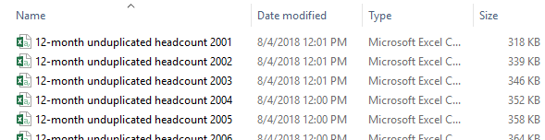
Data Cleanup & Exploration - NCES
NCES Exploration
Many different ways to pinpoint your data needs
User-friendly site, when you know exactly what you need
NCES Data Files Obtained
Separate enrollment files per year (2001-2017)
Separate completion (a.k.a., degrees awarded) files per year
(2001-2017 for enrollment, 2005-2017 for completions)
Merged using “copy*combine.csv” command line
Cleanup
Removed extraneous columns
Removed rows with missing data
Problems
Many holes in the completion data

Slide 5
Data Analysis
Group data by year
Calculated the average Rate of Change
Visualized the data via MatPlotLib line, bar, and pie charts
Layered the visuals to look for correlations
Used excel to look for regression values

Slide 6
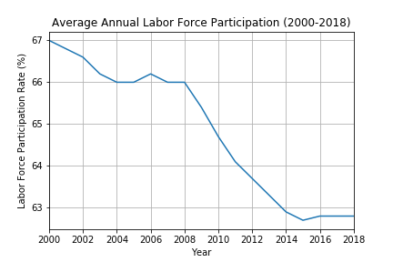
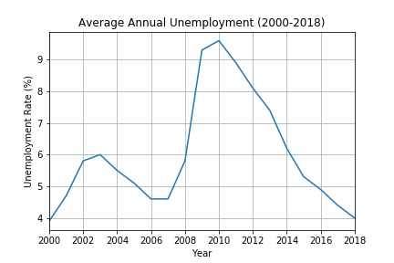
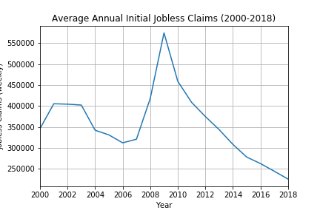

Slide 7
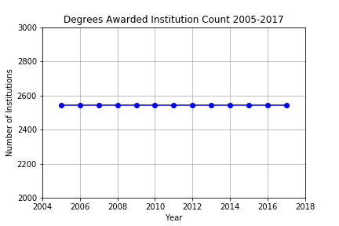
Degree Completion
Degree Completion data contains data for FOUR Degree Types from 2,544 institution (2005-2017):
One year certification
Two year certification
Associates Degree
Bachelor’s Degree

Slide 8
Data Frame was processed with
Remove unwanted columns
Rename, re-arrange columns
Convert empty cells to ‘0’; do not delete!
Add up sum of degrees per year with .groupby function
Created summary table with total degree per year per Degree type with Pandas dictionary
CompletionPerYear = pd.DataFrame({"Shorter Certificates":df5,
"Longer Certificates": df6,
"Associates Degree": df7,
"Bachelors Degree" : df8})
Total degree awarded per year = Add all 4 degrees awarded year
Plotting
Notes:
We removed the column for Master’s degree awarded since it is not in our scope.

Slide 9
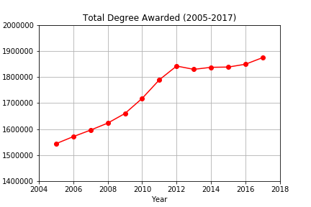
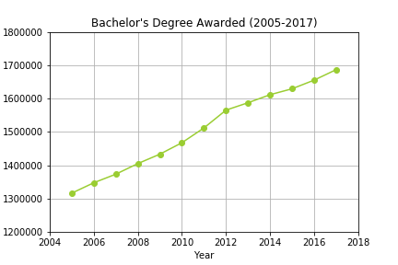
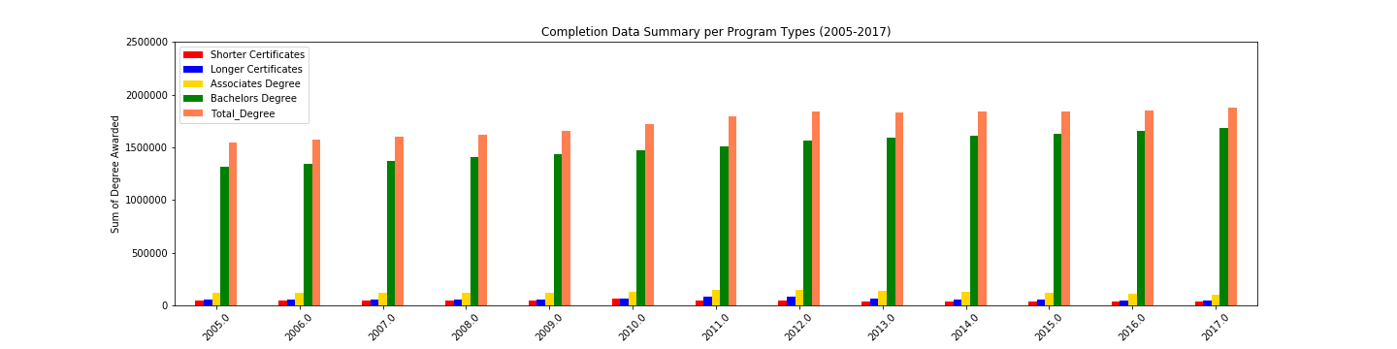
Summary of Degrees Awarded
On average ~87% of total graduates had Bachelor's Degree

Slide 10
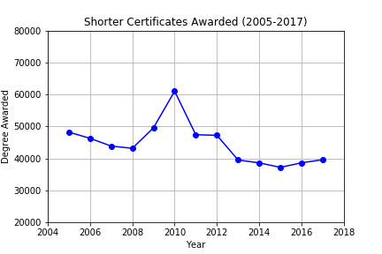
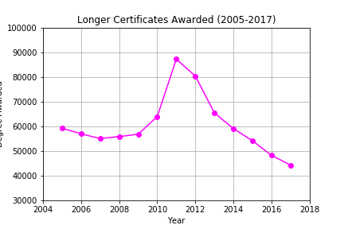
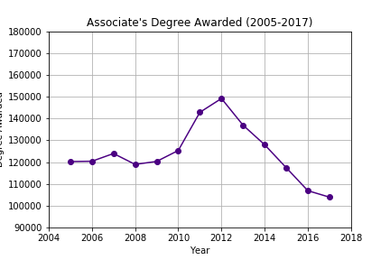
Trend in Degrees Awarded
Increase in short term degrees with increase in unemployment rate

Slide 11
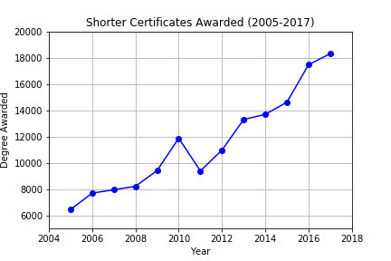
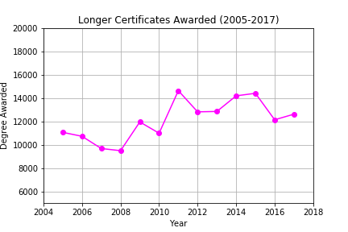
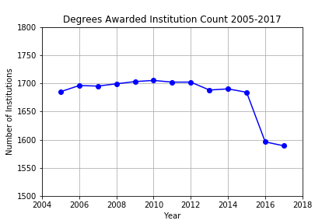
.dropna function to delete empty cells
*Deleting empty cells with .dropna function in a multicolumn data frame causes mis-representation of data.
*With .dropna, deleted ~11,000 rows!
*Convert NaN to ‘0’ value instead.
Notes:
Use to covert NaN to ‘0’:
df.fillna(value=0)

Slide 12
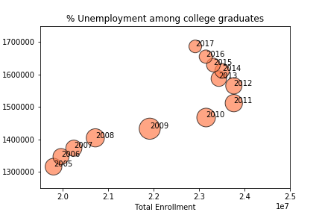

Slide 13
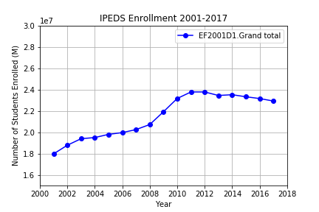
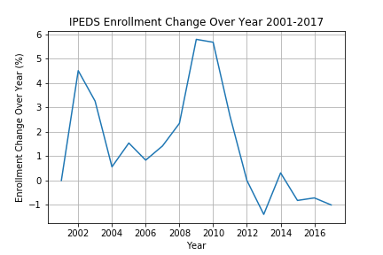
IPEDS Enrollment Data

Slide 14
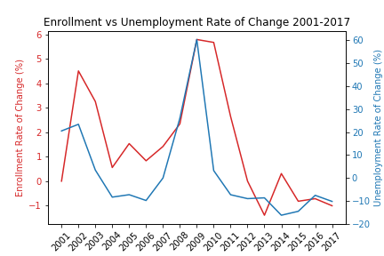
Discussion
* Discuss your findings. Did you find what you expected to find? If not, why not? What inferences or general conclusions can you draw from your analysis?

Slide 15
Post Mortem
* Discuss any difficulties that arose, and how you dealt with them * Discuss any additional questions that came up, but which you didn't have time to answer: What would you research next, if you had two more weeks?

Slide 16
Questions
* Open-floor Q&A with the audience

